Slide 1

“Use Your Words!”
Consent

Slide 2
Consent…
Is a clear and ENTHUSIASTIC “Yes”
Any signs of discomfort should be read as a “No”
Only meaningful if it is NOT coerced
A shared responsibility of everyone engaging in or who wants to engage in any kind of sexual interaction.
Must be…
  freely given, reversible, enthusiastic, informed and specific with both words and behaviors matching.

Slide 3

Age of consent
The legal age at which an individual
is considered mature enough to consent to sex.
NV: 16
  The age of consent varies by state.
  Consent CAN NOT be given when an individual is under the influence of drugs and/or alcohol.

Slide 4


Consent Communication
In a healthy relationship, both partners are able to openly talk about and agree on what kind of activity they want to engage in.
Whether it’s holding hands, kissing, touching, intercourse, or anything else, it’s really important for everyone in the relationship to feel comfortable with what’s happening.

Slide 5
Consent looks like…
When you’re engaging in sexual activity, consent is about communication.
And it should happen every time - continuously checking in with your partner.
Giving consent for one activity, one time, does not mean giving consent for increased or recurring sexual contact.
  For example, agreeing to kiss someone doesn’t give that person permission to remove your clothes or touch your genitals.
  Having sex with someone in the past doesn’t give that person permission to have sex with you again in the future.
  Sexual activity should only occur at the pace at which everyone is comfortable with.
https://www.rainn.org/articles/what-is-consent

Slide 6

You can change your mind at any time
You can withdraw consent at any point.
It’s important to clearly communicate to your partner that you are no longer comfortable with this activity and wish to stop.
The best way to ensure both parties are comfortable with any sexual activity is to talk about it.

Slide 7

Video: Consent Explained

Slide 8
Consent is NOT …
Refusing to acknowledge “no”
Assuming that wearing certain clothes, flirting, or kissing is an invitation for anything more
Someone being under the legal age of consent, as defined by the state
Someone being incapacitated because of drugs or alcohol
Pressuring someone into sexual activity by using fear or intimidation
Assuming you have permission to engage in a sexual act because you’ve done it in the past

Slide 9
About Sexual Assault
Sexual violence happens in every community and affects people of all genders and ages.
Sexual violence is any type of unwanted sexual contact. This includes words and actions of a sexual nature against a person’s will and without their consent.
A person may use force, threats, manipulation, or coercion to commit sexual violence.
Notes:
WCSD Admin Reg 5701: Sexual Harassment is defined as unwelcome sexual advances, requests for sexual favors, and other verbal or physical conduct of a sexual nature when submission to or rejection of this conduct explicitly or implicitly affects an individual's ability to receive an education, unreasonably interferes with an individual's educational performance or creates an intimidating, hostile or offensive educational environment. The term sexual harassment includes sexual violence under Title IX.

Slide 10
What it may look like…
Rape or sexual assault
Child sexual assault and incest
Sexual assault by a person’s spouse or partner
Unwanted sexual contact/touching
Sexual harassment
Sexual exploitation and trafficking
Exposing one’s genitals or naked body to other(s) without consent
Masturbating in public
Watching someone engage in private acts without their knowledge or permission
Nonconsensual image sharing (sexting)

Slide 11
What should I do if I see someone being assaulted?
Create a distraction: Do what you can to interrupt the situation. A distraction can give the person at risk a chance to get to a safe place.
Ask directly: Talk directly to the person who might be in trouble.
Refer to an authority: Sometimes the safest way to intervene is to refer to a neutral party with the authority to change the situation, like a teacher or other trusted adult.
Enlist others: It can be intimidating to approach a situation alone. Enlist another person to support you.
RAINN (Rape, Abuse & Incest National Network) is the nation's largest anti-sexual violence organization. RAINN created and operates the National Sexual Assault Hotline (800.656.HOPE, online.rainn.org y rainn.org/es)

Slide 12

Remember…
Unless it’s an enthusiastic YES for both you and your partner, it’s an absolute no.

Slide 13
Who to contact for help… take a pic!
The Anti Violence Project– serves people who are LGBTQ
Hotline 212-714-1124 Bilingual 24/7
GLBT National Help Center
Hotline 1800-246-PRIDE (1-800-246-7743) or
Online Chat at http://www.volunteerlogin.org/chat/
National Sexual Assault Hotline – supports LGBTQ people
1-800-656-HOPE (4673) 24/7 or
Online Counseling at https://ohl.rainn.org/online/
Awaken- 775-393-9183
Love Is Respect hotline: 1-866-331-99474 (24/7) or Text “loveis” 22522
Step Up! Nevada, Stop Violence! http://www.stepupstopviolence.org/
  SASS – Sexual Assault Support Services
      Call (775) 221-7600 & ask to speak with an Advocate
      Text: “SASS” to 839863
Domestic Violence Resource Center: 775-329-4150
Safe Embrace: 775-322-3466
Crisis Support Services: 1-800-273-8255
  Text “care” to 839863
Wingspan– serves people who are LGBTQ
Hotline 520-624-0348 or 1-800-553-9387 Bilingual 24/7

Slide 14
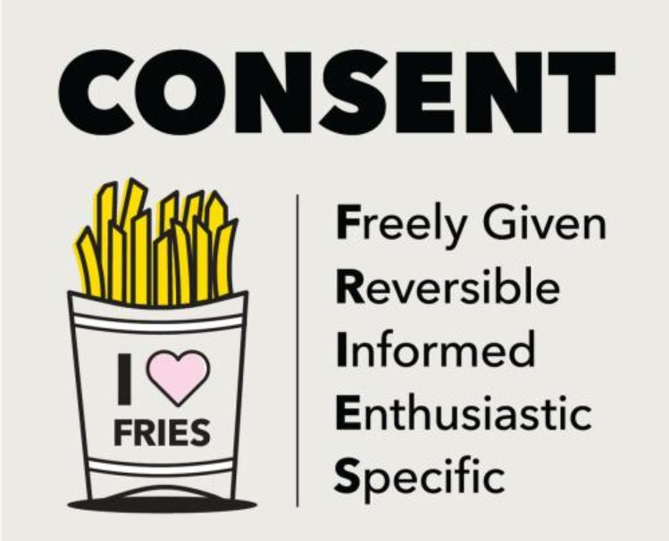
Positive consent can look like this:
Communicating every step of the way.
Respecting that when they don’t say “no,” it doesn’t mean “yes.” Consent is a clear and enthusiastic yes! If someone seems unsure, stays silent, doesn’t respond, or says “Maybe…” then they aren’t saying “yes.”
Using physical cues to let the other person know you’re comfortable taking things to the next level.
Breaking away from gender “rules.” Girls are not the only ones who might want to take it slow. Also, it’s not a guy’s job to initiate the action (or anything else, really).
Notes:
Why consent is not simply, “no means no” You may have heard the phrase “no means no.” That’s totally true, but it doesn’t really provide a complete picture of consent because it puts the responsibility on one person to resist or accept an activity. It also makes consent about what someone doesn’t want to do, instead of being about openly expressing what they do want to do.

Slide 15
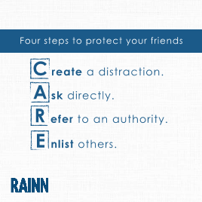
How can I play a role in preventing sexual assault?
This approach to preventing sexual assault is referred to as “bystander intervention.”

